Slide 1

Automated Cyberbullying Detection on Social Media
A Comparative Analysis of DistilBERT and Traditional ML Models
Ardil SUNGU
Student ID: 1031510019
Erciyes University | Faculty of Engineering
Department of Software Engineering

Slide 2

The Rising Threat
Digital Era Challenges
Social media grew very fast and changed how we speak, but it also helped bad behavior spread. Since there are billions of messages every day, it is impossible for humans to check them all by hand.
The Solution
We need automated tools that understand language. The goal of this project is to build a strong system that finds and labels cyberbullying instantly.

Slide 3

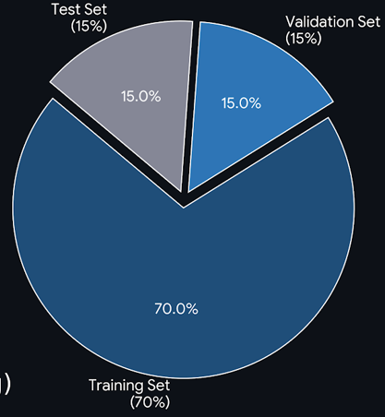
DATASET
Dataset Overview :
Source: Kaggle / Cyberbullying Classification
Total Size : 47000 Labeled Tweets
Classes: 6 Balanced Categories (age, ethnicity, gender, religion, other, not cyberbullying)
Experiment Split Strategy:
* Training Set: %70
* Validation Set: %15
* Test set: %15

Slide 4
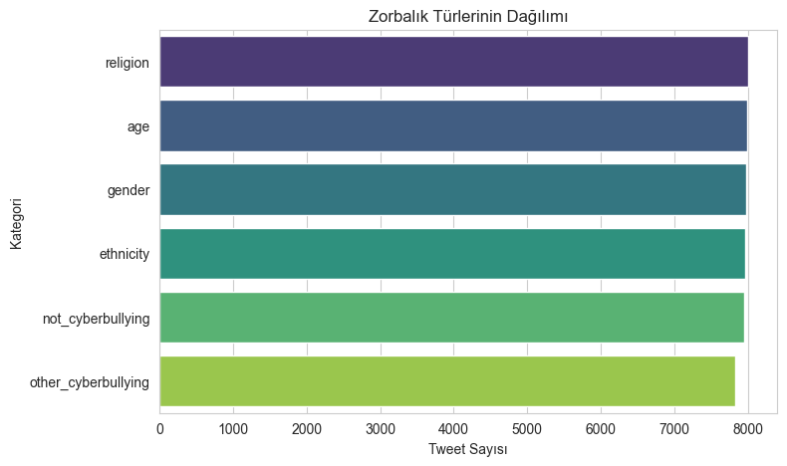



Project Objectives
Multiclass Classification
Go beyond binary detection ("Bullying" vs "Not") to identify specific types: Racism, Gender, Religion, etc.

Slide 5
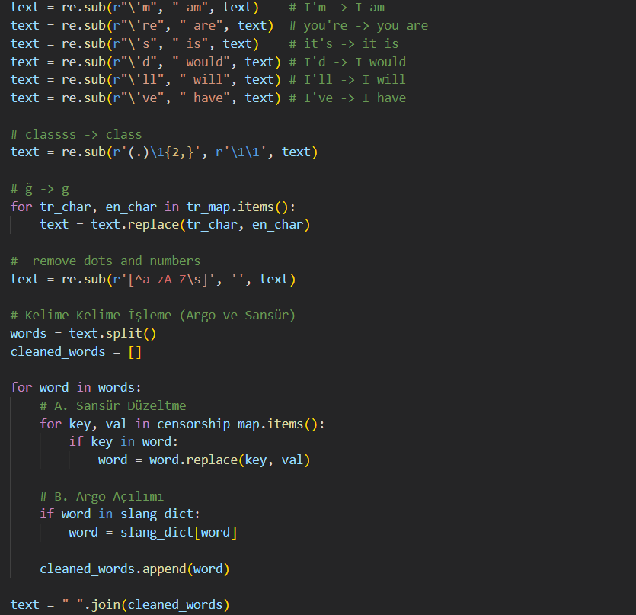
Methodology: Text Preprocessing
Traditional Pipeline
Used for SVM & Logistic Regression. Heavy cleaning to reduce data sparsity.
Noise Removal: URLs, HTML tags, @mentions.
Normalization: Lowercase, expanding contractions.
Lemmatization: Reducing words to roots (e.g., "running" → "run").
Stopword Removal: Removing common words.

Slide 6
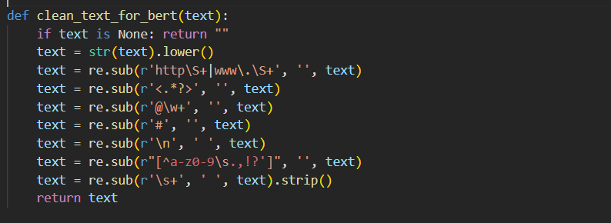
Methodology: Text Preprocessing
BERT Pipeline
Used for DistilBERT. Minimalist approach to preserve context.
Stopwords Retained: Crucial for understanding sentence structure.
Tokenization: Using WordPiece tokenizer specific to BERT.
Formatting: Simple lowercasing and URL removal.
Context Preservation: Punctuation kept for semantic meaning.

Slide 7
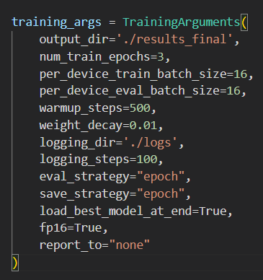
Model Configuration & Training Strategy
Implementation Framework
Platform: Hugging Face Ecosystem (Transformers Library).
Base Model: distilbert-base-uncased
Optimization: Mixed Precision (FP16) enabled for faster training and reduced memory usage.
Strategy: The model is fine-tuned on the training set, and the checkpoint with the highest validation accuracy is selected.
Parameter | Value
Batch Size | 16 (Train & Eval)
Epochs | 3
Learning Rate | 2e-5 (Standard for BERT)
Warmup Steps | 500
Weight Decay | 0.01
Max Sequence | 128 Tokens
Hugging Face Ecosystem:
-The leading open-source platform for Natural Language Processing (NLP).
-Serves as a central hub hosting pre-trained Transformer models (like DistilBERT).

Slide 8
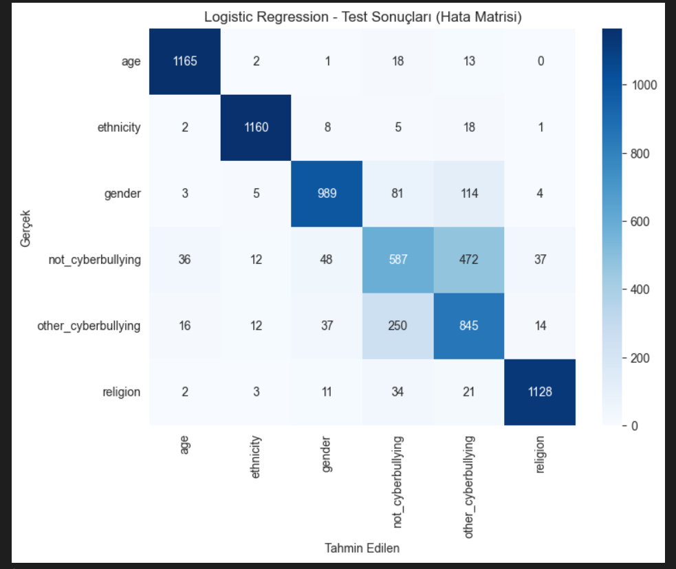

Models Implemented
Logistic Regression
A baseline linear model using TF-IDF vectors. Simple and interpretable but struggles with complex context.

Slide 9
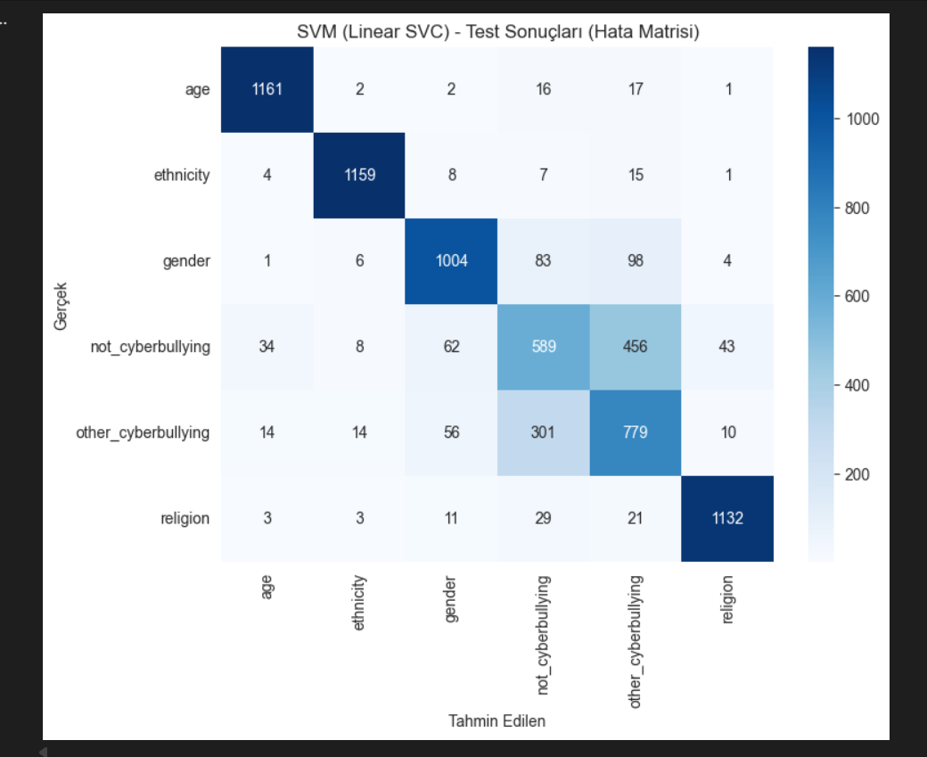

Models Implemented
Linear SVM
Support Vector Machine finds the optimal hyperplane. Effective for high-dimensional text data.

Slide 10
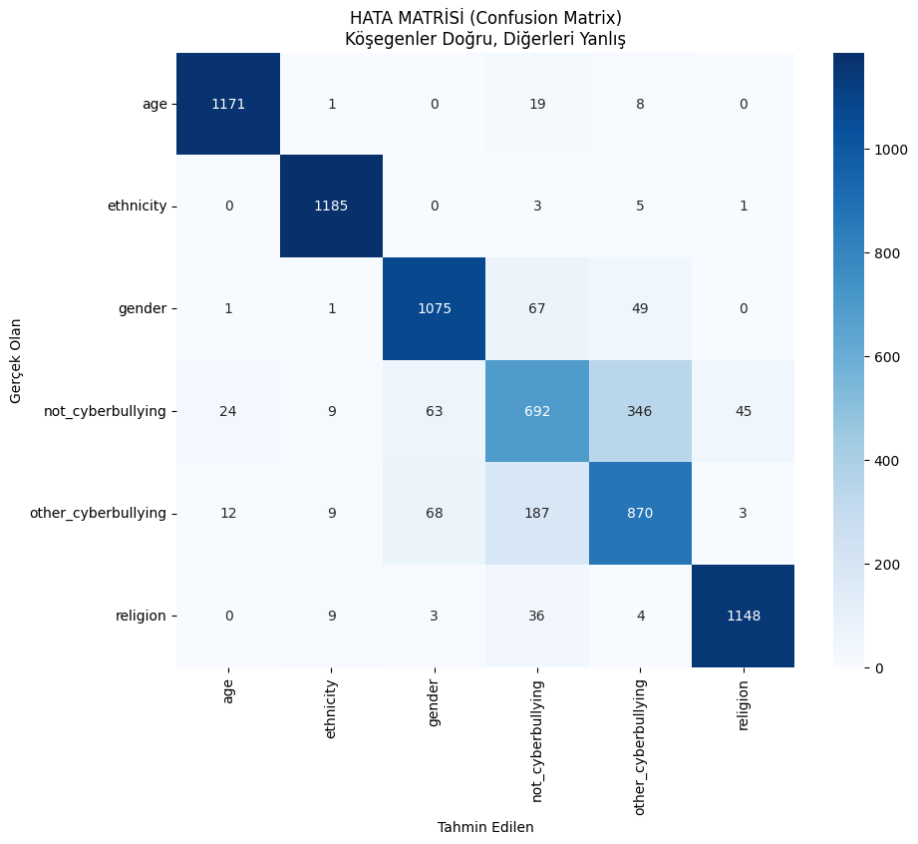

Models Implemented
DistilBERT
A distilled version of BERT. A Transformer model that understands context and word relationships bidirectionally.

Slide 11
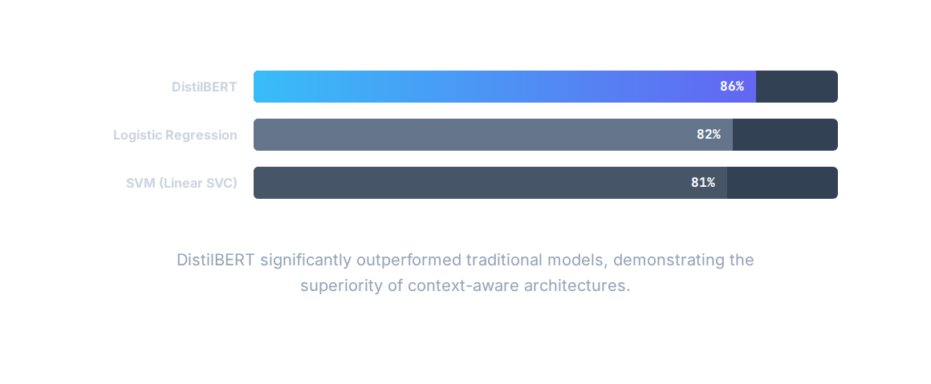
Performance Results: Accuracy

Slide 12
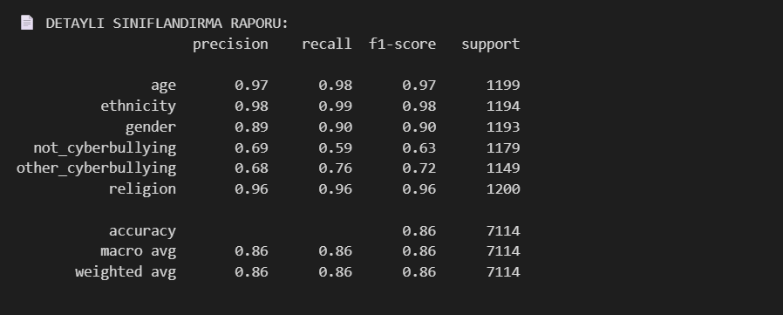
Class-wise Performance (DistilBERT)
Overall Accuracy: The model achieved an 86% accuracy rate across all classes
Top Performance: Excellent detection capabilities in Ethnicity (98%), Age (97%), and Religion (96%) classes.
Challenging Areas: Performance drops when distinguishing between not_cyberbullying and other_cyberbullying
Conclusion: DistilBERT excels at identifying specific targeted hate speech but faces challenges with the "gray areas" of general bullying and non-bullying text

Slide 13

The Power of Context
Why DistilBERT Wins
Traditional models (Bag-of-Words) treat words independently, often failing to detect sarcasm or implicit bullying. DistilBERT analyzes the entire sentence structure.
Reducing False Positives
Logistic Regression wrongly flagged 472 harmless tweets as "Other Bullying". DistilBERT reduced this error by over 25% (to 346), proving its ability to understand intent.

Slide 14
Conclusion & Future Work
86%
DL
6
Accuracy Achieved
Superior Architecture
Classes Detected
Transformer-based models are essential for modern moderation. Future work will focus on integrating irony detection modules to further improve the detection of implicit bullying.

Slide 15
Thank you listening to me
Ardıl Sungu
1031510019

